Slide 1
forta network analytics
Analysis and reverse engineering of bots
Mohit Anand
Rupin Jairaj
Wenlong Yang

Slide 2
Goal: Get Purposes + Rules
Building simple bots to monitor specific addresses.
Iteration 1
Analysing existing bots
Automate API call extraction by scraping the web docs and scanning code files for API usage
Iteration 2
Realized static analysis was not possible because not all bots executed smart contracts the smart contracts were protocol specific.
Iteration 3
Landed on manual extraction of bot rules

Slide 3
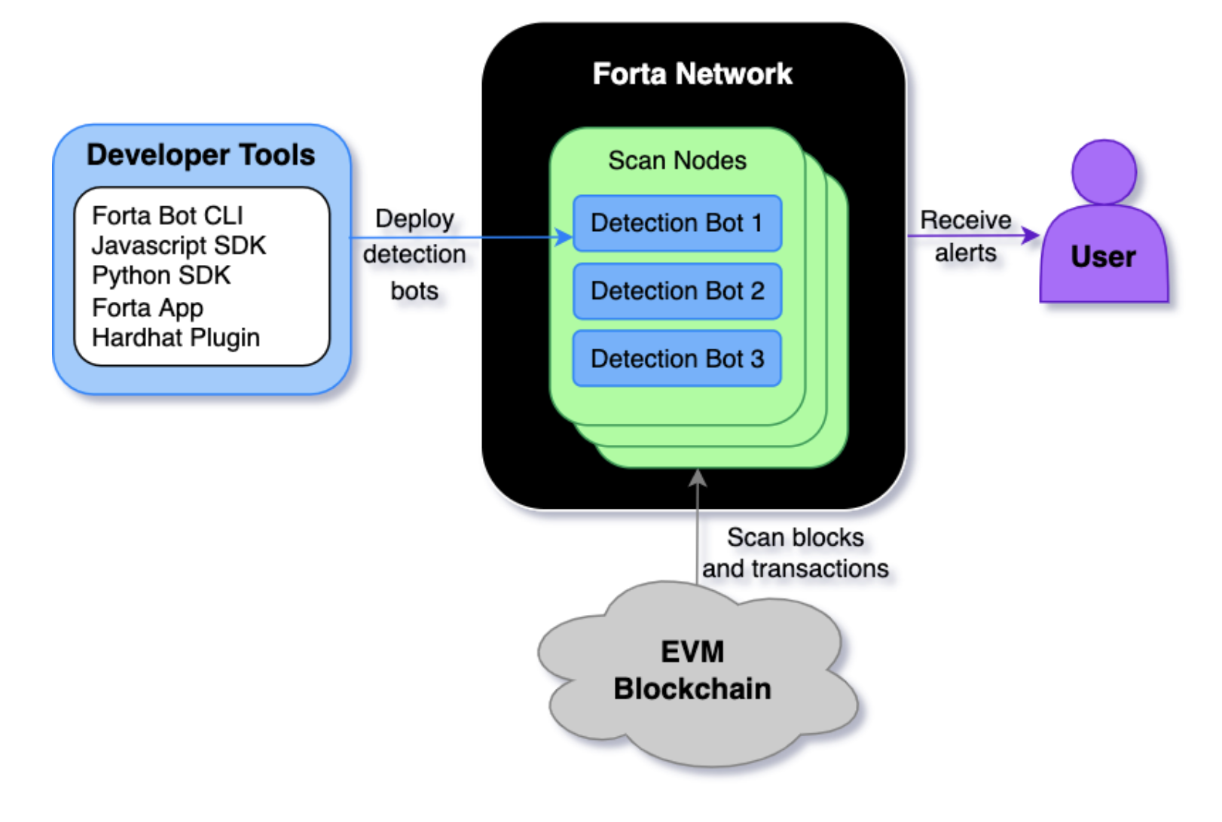
This and ether.js is all we need to use

Slide 4
Ice Phishing Detection
Purpose: This bot detects if an account gains a large number of approvals and if it transfers the approved funds.
Rules:
Filters transaction logs for these events:
event Approval(address indexed owner, address indexed spender, uint256 value)
event Approval(address indexed owner, address indexed spender, uint256 indexed tokenId)
event ApprovalForAll(address indexed owner, address indexed spender, bool approved)
event Transfer(address indexed from, address indexed to, uint256 value)
event Transfer(address indexed from, address indexed to, uint256 indexed tokenId)
event TransferSingle(address indexed operator, address indexed from, address indexed to, uint256 tokenId, uint256 value)
event TransferBatch(address indexed operator, address indexed from, address indexed to, uint256[] tokenIds, uint256[] values)
Keeps track of addresses involved in Approval events in an LRU cache.
Filters out approval revokes.
Constantly clears out the LRU cache of old records beyond a configured threshold.
If we notice a high number of approvals for a specific spender we record the spender’s address.
Return a finding with the snapshot of the LRU cache after a configured amount of time.

Slide 5
ETH
Changes in Block Difficulty
Purpose: Detect unusual changes in block difficulty
Rules:
Maintains an array in memory to store the block mining difficulty for the last 100 (or some configured limit) blocks.
Returns a finding if the difficulty of the current block crosses some configured threshold.
Calculates a moving average of bot difficulties captured so far. If the percentage change of the current bot difficulty exceeds the moving average by a configured threshold we return a finding.

Slide 6
Chain Link Agent
Purpose: Detects price updates
Rules:
Filters transaction logs for the following event ABIs:
event AnswerUpdated(int256 indexed current, uint256 indexed roundId, uint256 updatedAt)
Executes the getAnswer() smart contract on the ChainLink protocol to get the previous round’s answer (price).
Return a finding if the price difference between the current round’s answer and the previous round’s answer is greater than a configured threshold.

Slide 7
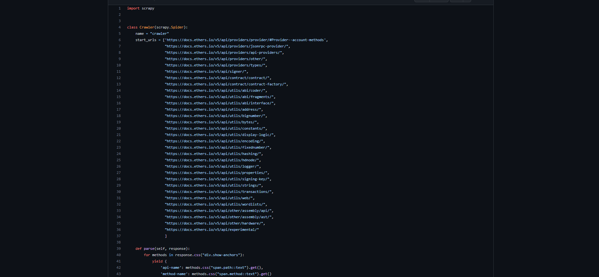
Crawler Code

Slide 8
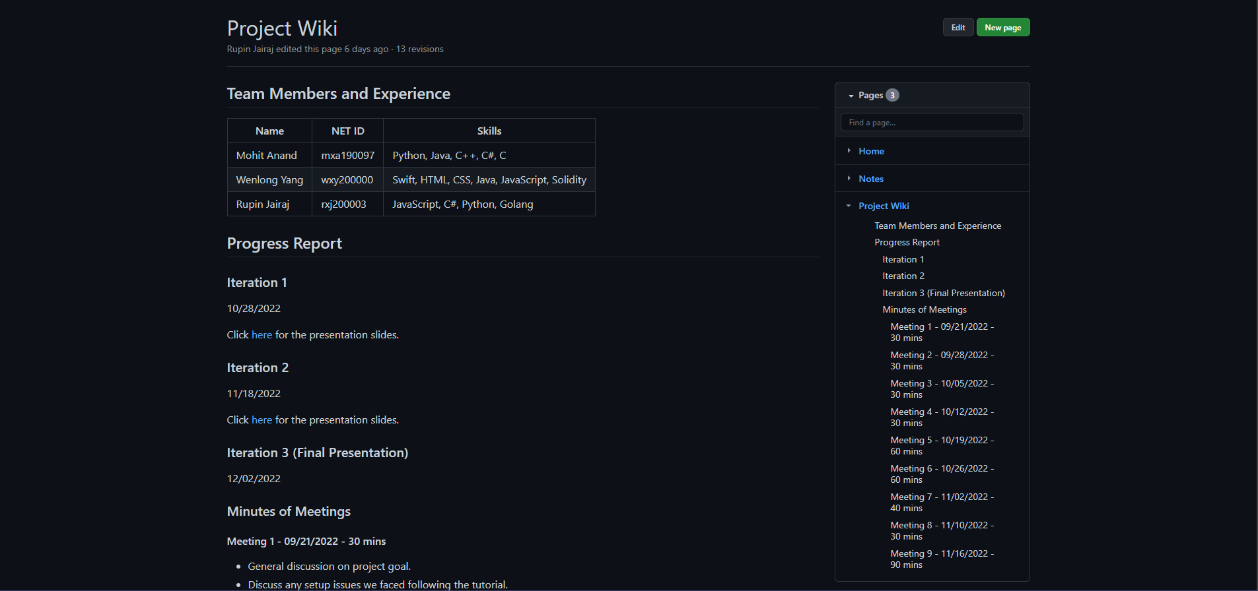
Project Wiki Page

Slide 9
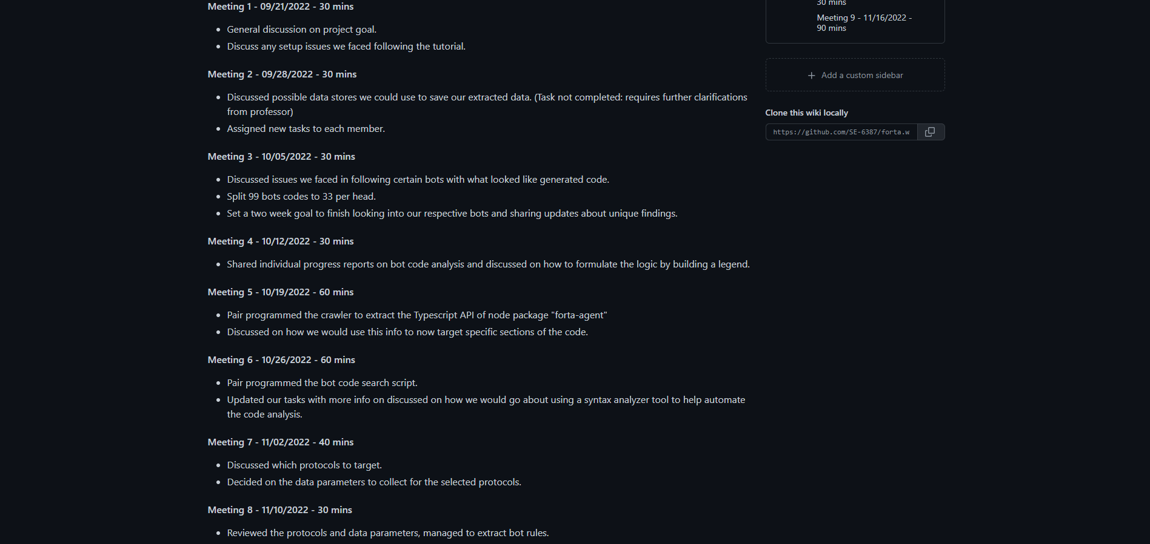

Slide 10
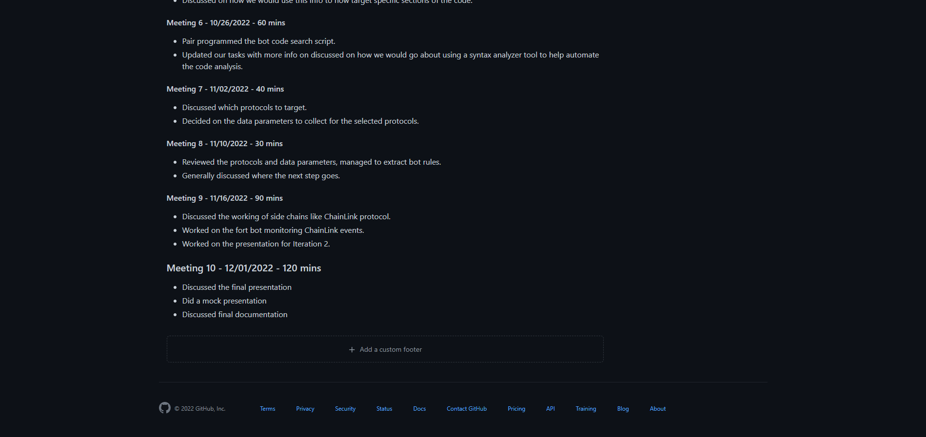

Slide 11
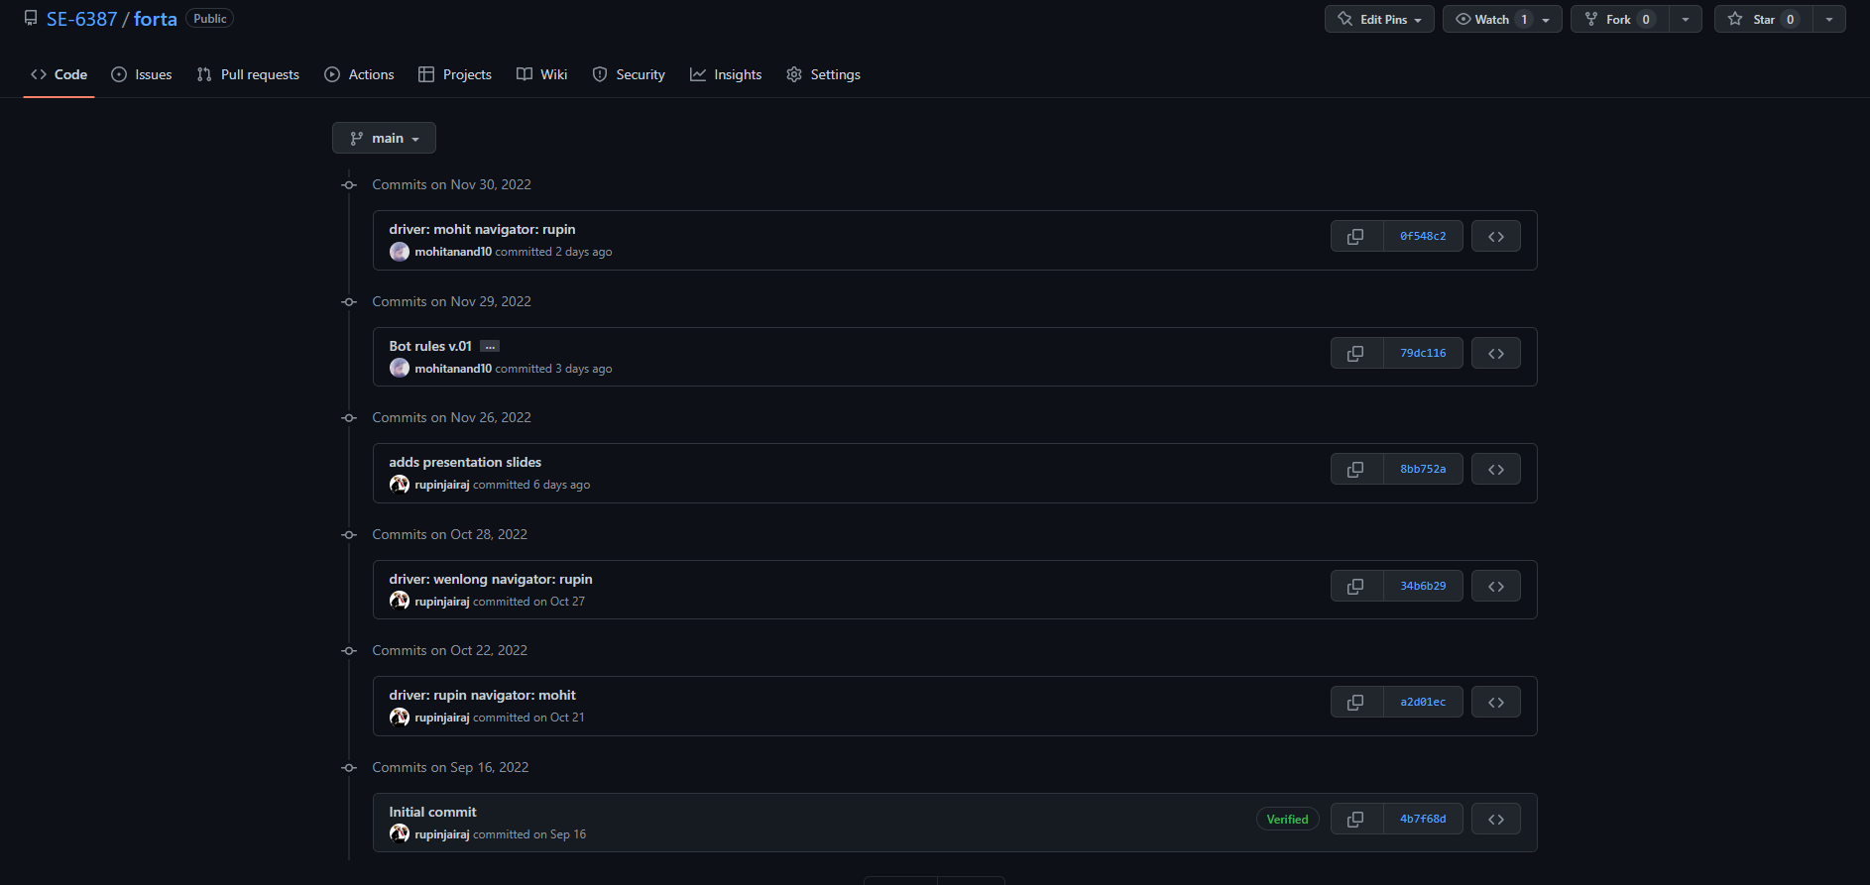
Commit Log

